Slide 1
Agile Development
— a presentation by Dr. K
Based on Chapter 3 of
Software Engineering: A Practitioner’s Approach (9th ed.)
by Roger Pressman and Bruce Maxim.
Notes:
Hello, this is Dr. K, and welcome to this module on agile development. This material is based on chapter 3 of Software Engineering: A Practitioner’s Approach, 9th edition, by Roger Pressman and Bruce Maxim.

Slide 2
The Agile Manifesto
Notes:
In this section we're going to talk about the agile manifesto. We’re going to talk about what it is and how it came about.

Slide 3

Agile Methods
— Yann Allegre
Unsplash
Notes:
Agile Development has an interesting history. In the 1990s there were a lot of software developers and software engineering researchers who were critical of traditional software development practice. They saw conventional software development as something that was plagued by rigid software processes, bogged-down by hard-to-maintain documentation, and engulfed in requirements churn. Some of these critics had developed alternative software processes, like extreme programming and crystal clear. Back then, these methodologies were known as *lightweight* software processes. As critics often do, they all had their own idea of what was the best alternative to the traditional approach. So in 2001, about 20 of them met at the Snowbird resort in Utah, and they tried to see if there was anything they could agree upon. Remarkably, there was. The result of that meeting was the Agile Manifesto, and it really had a significant impact on the software development community.

Slide 4
Agile Manifesto
We are uncovering better ways of developing software by doing it and helping others do it. Through this work we have come to value:
Individuals and interactions over processes and tools
Working software over comprehensive documentation
Customer collaboration over contract negotiation
Responding to change over following a plan
That is, while there is value in the items on the right, we value the items on the left more.
Notes:
Here is what the Agile Manifesto says. [–] The first thing to notice is that they want to emphasize that they are software developers. They are not just business people, they are not just researchers, they are builders of software. And they are out there getting their hands dirty. They’ve seen the problems, they’ve seen the mistakes, and they have a good idea of what needs to be done to correct them. [–] The manifesto itself is a statement of emphasis. It asserts what should be *valued* in software development. [–] As I go through each of these bullet points, I will be quoting a lot from Robert Martin, who was one of the people at Snowbird. He developed the principles of agility, and he wrote an excellent article on the manifesto and the principles. It became chapter 1 of a book called *Agile Principles, Patterns, and Practices in C#* and it’s one of your reading assignments for this week. Okay, let’s look at these four *values* of the manifesto.
[next] The first item here talks about valuing individuals and interactions over processes and tools. You don’t have to pause the video for this, but if I give you five seconds, can you come up with one example of a process and one example of a tool in the sense they are referring to here? Five seconds starting now. [pause 5 seconds]. Okay, it’s not a trick question. A process could be a process model like the waterfall or the spiral, and a tool is a development tool, like Eclipse or Rational Rose. There may be nifty processes and tools out there, and of course we are always interested in the newest, shiniest thing. But the most important resources are talented individuals. [–] Having said that, don’t forget about *interactions*. How developers and others interact on a team can be more important than having pure programming talent. Here’s what Martin says: “A strong player is not necessarily an ace programmer. A strong player may be an average programmer but someone who works well with others. Working well with others – communicating and interacting – is more important than raw programming talent.” This notion of communication skills is going to crop up again and again in agile development. As we will see, it’s not just about the interaction between developers, but the interaction between developers and their customers is also critical to success.
[next] The second item is probably a very welcome one for any developer. There is a real fear among developers that they will get bogged down in creating documentation and that will take away from coding time. Martin says that there is a balance here. Too *little* documentation is bad, and too *much* documentation is bad also. But, Martin also says this: “Too much documentation is *worse* than too little.” I think that comment deserves a bit of thought. Part of the problem with too much documentation is that it takes time to produce. Okay. But there is a more serious problem with a lot of documentation. So please, pause the video, and try to figure out why someone would say that too much documentation is worse than too little.
[next] Okay, let’s talk about the third item: customer collaboration over contract negotiation. When you are negotiating something, it implies an adversarial relationship. When you are collaborating, everyone is part of the same team. And that’s the attitude you should have. That the customers and the developers are on the same team. This close developer-customer interaction is a critical part of agile methodology, and it is a key factor in mitigating requirements churn. If developers and customers work together continuously, it’s much easier to accommodate change.
[next] That brings us to the final item: responding to change over following a plan. The ability to respond to change is what *agility* has come to mean in the context of software engineering. Remember that one of the themes that Pressman rightly emphasizes over and over again is that of change. The fact that software will change, software must change, and software thrives on change. There is nothing wrong with having a plan, but make sure that plan is flexible enough to respond to change. As Martin says: “Make detailed plans for the next week, rough plans for the next 3 months, and extremely crude plans beyond that.”

Slide 5
Agile Manifesto: Individuals and Interactions
We are uncovering better ways of developing software by doing it and helping others do it. Through this work we have come to value:
Individuals and interactions over processes and tools
Working software over comprehensive documentation
Customer collaboration over contract negotiation
Responding to change over following a plan
That is, while there is value in the items on the right, we value the items on the left more.
Notes:
Here is what the Agile Manifesto says. [–] The first thing to notice is that they want to emphasize that they are software developers. They are not just business people, they are not just researchers, they are builders of software. And they are out there getting their hands dirty. They’ve seen the problems, they’ve seen the mistakes, and they have a good idea of what needs to be done to correct them. [–] The manifesto itself is a statement of emphasis. It asserts what should be *valued* in software development. [–] As I go through each of these bullet points, I will be quoting a lot from Robert Martin, who was one of the people at Snowbird. He developed the principles of agility, and he wrote an excellent article on the manifesto and the principles. It became chapter 1 of a book called *Agile Principles, Patterns, and Practices in C#* and it’s one of your reading assignments for this week. Okay, let’s look at these four *values* of the manifesto.
[next] The first item here talks about valuing individuals and interactions over processes and tools. You don’t have to pause the video for this, but if I give you five seconds, can you come up with one example of a process and one example of a tool in the sense they are referring to here? Five seconds starting now. [pause 5 seconds]. Okay, it’s not a trick question. A process could be a process model like the waterfall or the spiral, and a tool is a development tool, like Eclipse or Rational Rose. There may be nifty processes and tools out there, and of course we are always interested in the newest, shiniest thing. But the most important resources are talented individuals. [–] Having said that, don’t forget about *interactions*. How developers and others interact on a team can be more important than having pure programming talent. Here’s what Martin says: “A strong player is not necessarily an ace programmer. A strong player may be an average programmer but someone who works well with others. Working well with others – communicating and interacting – is more important than raw programming talent.” This notion of communication skills is going to crop up again and again in agile development. As we will see, it’s not just about the interaction between developers, but the interaction between developers and their customers is also critical to success.
[next] The second item is probably a very welcome one for any developer. There is a real fear among developers that they will get bogged down in creating documentation and that will take away from coding time. Martin says that there is a balance here. Too *little* documentation is bad, and too *much* documentation is bad also. But, Martin also says this: “Too much documentation is *worse* than too little.” I think that comment deserves a bit of thought. Part of the problem with too much documentation is that it takes time to produce. Okay. But there is a more serious problem with a lot of documentation. So please, pause the video, and try to figure out why someone would say that too much documentation is worse than too little.
[next] Okay, let’s talk about the third item: customer collaboration over contract negotiation. When you are negotiating something, it implies an adversarial relationship. When you are collaborating, everyone is part of the same team. And that’s the attitude you should have. That the customers and the developers are on the same team. This close developer-customer interaction is a critical part of agile methodology, and it is a key factor in mitigating requirements churn. If developers and customers work together continuously, it’s much easier to accommodate change.
[next] That brings us to the final item: responding to change over following a plan. The ability to respond to change is what *agility* has come to mean in the context of software engineering. Remember that one of the themes that Pressman rightly emphasizes over and over again is that of change. The fact that software will change, software must change, and software thrives on change. There is nothing wrong with having a plan, but make sure that plan is flexible enough to respond to change. As Martin says: “Make detailed plans for the next week, rough plans for the next 3 months, and extremely crude plans beyond that.”

Slide 6
Agile Manifesto: Working Software
We are uncovering better ways of developing software by doing it and helping others do it. Through this work we have come to value:
Individuals and interactions over processes and tools
Working software over comprehensive documentation
Customer collaboration over contract negotiation
Responding to change over following a plan
That is, while there is value in the items on the right, we value the items on the left more.
Notes:
Here is what the Agile Manifesto says. [–] The first thing to notice is that they want to emphasize that they are software developers. They are not just business people, they are not just researchers, they are builders of software. And they are out there getting their hands dirty. They’ve seen the problems, they’ve seen the mistakes, and they have a good idea of what needs to be done to correct them. [–] The manifesto itself is a statement of emphasis. It asserts what should be *valued* in software development. [–] As I go through each of these bullet points, I will be quoting a lot from Robert Martin, who was one of the people at Snowbird. He developed the principles of agility, and he wrote an excellent article on the manifesto and the principles. It became chapter 1 of a book called *Agile Principles, Patterns, and Practices in C#* and it’s one of your reading assignments for this week. Okay, let’s look at these four *values* of the manifesto.
[next] The first item here talks about valuing individuals and interactions over processes and tools. You don’t have to pause the video for this, but if I give you five seconds, can you come up with one example of a process and one example of a tool in the sense they are referring to here? Five seconds starting now. [pause 5 seconds]. Okay, it’s not a trick question. A process could be a process model like the waterfall or the spiral, and a tool is a development tool, like Eclipse or Rational Rose. There may be nifty processes and tools out there, and of course we are always interested in the newest, shiniest thing. But the most important resources are talented individuals. [–] Having said that, don’t forget about *interactions*. How developers and others interact on a team can be more important than having pure programming talent. Here’s what Martin says: “A strong player is not necessarily an ace programmer. A strong player may be an average programmer but someone who works well with others. Working well with others – communicating and interacting – is more important than raw programming talent.” This notion of communication skills is going to crop up again and again in agile development. As we will see, it’s not just about the interaction between developers, but the interaction between developers and their customers is also critical to success.
[next] The second item is probably a very welcome one for any developer. There is a real fear among developers that they will get bogged down in creating documentation and that will take away from coding time. Martin says that there is a balance here. Too *little* documentation is bad, and too *much* documentation is bad also. But, Martin also says this: “Too much documentation is *worse* than too little.” I think that comment deserves a bit of thought. Part of the problem with too much documentation is that it takes time to produce. Okay. But there is a more serious problem with a lot of documentation. So please, pause the video, and try to figure out why someone would say that too much documentation is worse than too little.
[next] Okay, let’s talk about the third item: customer collaboration over contract negotiation. When you are negotiating something, it implies an adversarial relationship. When you are collaborating, everyone is part of the same team. And that’s the attitude you should have. That the customers and the developers are on the same team. This close developer-customer interaction is a critical part of agile methodology, and it is a key factor in mitigating requirements churn. If developers and customers work together continuously, it’s much easier to accommodate change.
[next] That brings us to the final item: responding to change over following a plan. The ability to respond to change is what *agility* has come to mean in the context of software engineering. Remember that one of the themes that Pressman rightly emphasizes over and over again is that of change. The fact that software will change, software must change, and software thrives on change. There is nothing wrong with having a plan, but make sure that plan is flexible enough to respond to change. As Martin says: “Make detailed plans for the next week, rough plans for the next 3 months, and extremely crude plans beyond that.”

Slide 7
Pause and Think Documentation
How can too much documentation be worse than too little?
Notes:
[pause 5 seconds] Okay, this is interesting. We know that documentation takes time to produce. But it also takes time to *maintain* and to *keep in sync* with the code. And many people would claim that if your documentation in *not* sync with the code, it’s worse than having no documentation at all. Why is that? Because documentation that is not in sync with the code, is documentation that is *lying* to you. You read it, and it say that the code is doing one thing, but the code is doing something else. The code was updated, and the documentation was not. That is a serious problem. [–] So Martin has a law about documentation, and it’s this: “Produce no document unless its need is immediate and significant.”

Slide 8
Agile Manifesto: Customer Collaboration
We are uncovering better ways of developing software by doing it and helping others do it. Through this work we have come to value:
Individuals and interactions over processes and tools
Working software over comprehensive documentation
Customer collaboration over contract negotiation
Responding to change over following a plan
That is, while there is value in the items on the right, we value the items on the left more.
Notes:
Here is what the Agile Manifesto says. [–] The first thing to notice is that they want to emphasize that they are software developers. They are not just business people, they are not just researchers, they are builders of software. And they are out there getting their hands dirty. They’ve seen the problems, they’ve seen the mistakes, and they have a good idea of what needs to be done to correct them. [–] The manifesto itself is a statement of emphasis. It asserts what should be *valued* in software development. [–] As I go through each of these bullet points, I will be quoting a lot from Robert Martin, who was one of the people at Snowbird. He developed the principles of agility, and he wrote an excellent article on the manifesto and the principles. It became chapter 1 of a book called *Agile Principles, Patterns, and Practices in C#* and it’s one of your reading assignments for this week. Okay, let’s look at these four *values* of the manifesto.
[next] The first item here talks about valuing individuals and interactions over processes and tools. You don’t have to pause the video for this, but if I give you five seconds, can you come up with one example of a process and one example of a tool in the sense they are referring to here? Five seconds starting now. [pause 5 seconds]. Okay, it’s not a trick question. A process could be a process model like the waterfall or the spiral, and a tool is a development tool, like Eclipse or Rational Rose. There may be nifty processes and tools out there, and of course we are always interested in the newest, shiniest thing. But the most important resources are talented individuals. [–] Having said that, don’t forget about *interactions*. How developers and others interact on a team can be more important than having pure programming talent. Here’s what Martin says: “A strong player is not necessarily an ace programmer. A strong player may be an average programmer but someone who works well with others. Working well with others – communicating and interacting – is more important than raw programming talent.” This notion of communication skills is going to crop up again and again in agile development. As we will see, it’s not just about the interaction between developers, but the interaction between developers and their customers is also critical to success.
[next] The second item is probably a very welcome one for any developer. There is a real fear among developers that they will get bogged down in creating documentation and that will take away from coding time. Martin says that there is a balance here. Too *little* documentation is bad, and too *much* documentation is bad also. But, Martin also says this: “Too much documentation is *worse* than too little.” I think that comment deserves a bit of thought. Part of the problem with too much documentation is that it takes time to produce. Okay. But there is a more serious problem with a lot of documentation. So please, pause the video, and try to figure out why someone would say that too much documentation is worse than too little.
[next] Okay, let’s talk about the third item: customer collaboration over contract negotiation. When you are negotiating something, it implies an adversarial relationship. When you are collaborating, everyone is part of the same team. And that’s the attitude you should have. That the customers and the developers are on the same team. This close developer-customer interaction is a critical part of agile methodology, and it is a key factor in mitigating requirements churn. If developers and customers work together continuously, it’s much easier to accommodate change.
[next] That brings us to the final item: responding to change over following a plan. The ability to respond to change is what *agility* has come to mean in the context of software engineering. Remember that one of the themes that Pressman rightly emphasizes over and over again is that of change. The fact that software will change, software must change, and software thrives on change. There is nothing wrong with having a plan, but make sure that plan is flexible enough to respond to change. As Martin says: “Make detailed plans for the next week, rough plans for the next 3 months, and extremely crude plans beyond that.”

Slide 9
Agile Manifesto: Responding to Change
We are uncovering better ways of developing software by doing it and helping others do it. Through this work we have come to value:
Individuals and interactions over processes and tools
Working software over comprehensive documentation
Customer collaboration over contract negotiation
Responding to change over following a plan
That is, while there is value in the items on the right, we value the items on the left more.
Notes:
Here is what the Agile Manifesto says. [–] The first thing to notice is that they want to emphasize that they are software developers. They are not just business people, they are not just researchers, they are builders of software. And they are out there getting their hands dirty. They’ve seen the problems, they’ve seen the mistakes, and they have a good idea of what needs to be done to correct them. [–] The manifesto itself is a statement of emphasis. It asserts what should be *valued* in software development. [–] As I go through each of these bullet points, I will be quoting a lot from Robert Martin, who was one of the people at Snowbird. He developed the principles of agility, and he wrote an excellent article on the manifesto and the principles. It became chapter 1 of a book called *Agile Principles, Patterns, and Practices in C#* and it’s one of your reading assignments for this week. Okay, let’s look at these four *values* of the manifesto.
[next] The first item here talks about valuing individuals and interactions over processes and tools. You don’t have to pause the video for this, but if I give you five seconds, can you come up with one example of a process and one example of a tool in the sense they are referring to here? Five seconds starting now. [pause 5 seconds]. Okay, it’s not a trick question. A process could be a process model like the waterfall or the spiral, and a tool is a development tool, like Eclipse or Rational Rose. There may be nifty processes and tools out there, and of course we are always interested in the newest, shiniest thing. But the most important resources are talented individuals. [–] Having said that, don’t forget about *interactions*. How developers and others interact on a team can be more important than having pure programming talent. Here’s what Martin says: “A strong player is not necessarily an ace programmer. A strong player may be an average programmer but someone who works well with others. Working well with others – communicating and interacting – is more important than raw programming talent.” This notion of communication skills is going to crop up again and again in agile development. As we will see, it’s not just about the interaction between developers, but the interaction between developers and their customers is also critical to success.
[next] The second item is probably a very welcome one for any developer. There is a real fear among developers that they will get bogged down in creating documentation and that will take away from coding time. Martin says that there is a balance here. Too *little* documentation is bad, and too *much* documentation is bad also. But, Martin also says this: “Too much documentation is *worse* than too little.” I think that comment deserves a bit of thought. Part of the problem with too much documentation is that it takes time to produce. Okay. But there is a more serious problem with a lot of documentation. So please, pause the video, and try to figure out why someone would say that too much documentation is worse than too little.
[next] Okay, let’s talk about the third item: customer collaboration over contract negotiation. When you are negotiating something, it implies an adversarial relationship. When you are collaborating, everyone is part of the same team. And that’s the attitude you should have. That the customers and the developers are on the same team. This close developer-customer interaction is a critical part of agile methodology, and it is a key factor in mitigating requirements churn. If developers and customers work together continuously, it’s much easier to accommodate change.
[next] That brings us to the final item: responding to change over following a plan. The ability to respond to change is what *agility* has come to mean in the context of software engineering. Remember that one of the themes that Pressman rightly emphasizes over and over again is that of change. The fact that software will change, software must change, and software thrives on change. There is nothing wrong with having a plan, but make sure that plan is flexible enough to respond to change. As Martin says: “Make detailed plans for the next week, rough plans for the next 3 months, and extremely crude plans beyond that.”

Slide 10
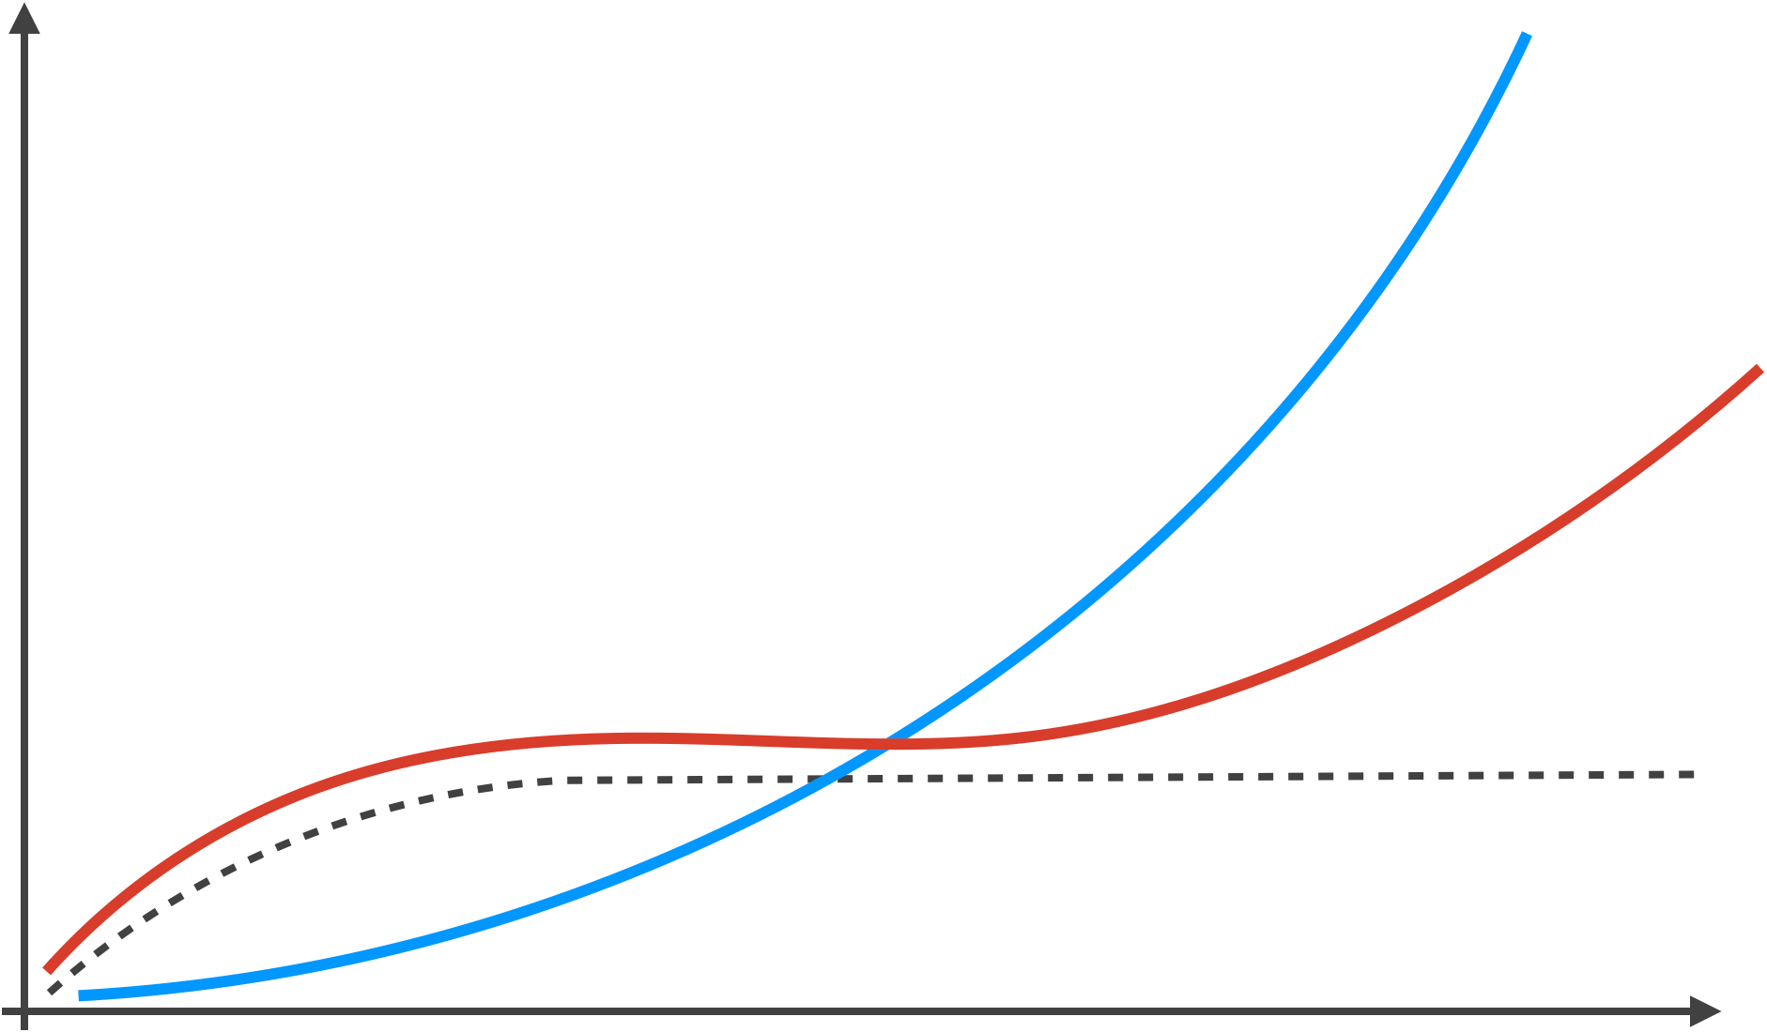
Agility and the Cost of Change
Cost of change using conventional software process
Cost of change using agile process
Development Costs
Idealized cost of change using agile
Development Schedule
Notes:
It’s conventional wisdom that change is relatively easy to deal with early in the development process, because it is close to where the requirements are collected, but it becomes much more difficult to deal with in the *later* stages of development. Advocates of agile methods argue that the cost of change for an agile development process looks more like a straight line (represented by the dotted line here). It is debatable to what extent this is true, but most developers feel that the truth is somewhere in between.

Slide 11
Principles of Agility
Priority: Early and continuous delivery of valuable software
Welcome changing requirements, even late in development
Deliver working software frequently (every few weeks)
Customers and developers work together daily
Build projects around motivated individuals
Face-to-face conversation is best
Working software is the primary measure of progress
Agile processes promote sustainable development
Technical excellence and good design enhance agility
Simplicity is essential
Use self-organizing teams
Periodically assess your team and change accordingly
Notes:
These are the 12 principles of agility. I’ve abbreviated them here so that they fit on one page, but we’ll see each principle in its entirety as we go through them.

Slide 12
Agile Principle #1
Our highest priority is to satisfy the customer through early and continuous delivery of valuable software.
There is a strong correlation between quality and the early delivery of a system.
There is also a strong correlation between final quality and frequent deliveries of increasing functionality.
— Martin
Notes:
This is the first and arguably the most important principle. The highest priority is to satisfy the customer through early and continuous delivery. Martin sites a study in the MIT Sloan Management Review that corroborates the effectiveness of this principle: namely that the quality of a software product is strongly correlated to early and frequent delivery. And remember this is delivery to the customer, which is not the same as a public release of the software. If you wait too long before you show the customer working software, the overall quality will suffer. And that should make sense, because the more the customer sees what the software is doing, the more they can give you meaningful feedback.

Slide 13
Agile Principle #2
Welcome changing requirements, even late in development. Agile processes harness change for the customer’s competitive advantage.
This is a statement of attitude.
— Martin
Notes:
Welcome changing requirements, even late in development. Okay, a bit of honesty here – I don’t know any developer who likes changing requirements late in development. That means you may have to throw away a lot of hard work that you’ve done. However, as Martin says, this is a statement of attitude. If you think of an agile process as getting closer and closer to the true software product with each successive iteration, then you can think of a requirements change as something that gets you closer to your ultimate goal. And that’s a good thing.

Slide 14
Agile Principle #3
Deliver working software frequently, from a couple of weeks to a couple of months, with a preference to the shorter time scale.
We deliver working software, and we deliver it early and often. We don’t count bundles of documents as true deliveries.
— Martin
Notes:
Deliver working software frequently. This principle tells us a couple things. First, it gets specific about how frequently you should deliver code to the customer. Preferably every few weeks. Second, that word *working* is critical. It’s implied in principle 1 when we say *valuable* software. It’s used here in principle 3, and we’ll see it again in principle 7. Just like Martin is saying here that documentation does not count as a true delivery, software that does not work doesn’t count as a true delivery either.

Slide 15
Agile Principle #4
Business people and developers must work together daily throughout the project.
A software project must be continuously guided.
— Martin
Notes:
Business people and developers work together daily. We want software development to be a true collaboration between customers and developers. It’s the customers who have the requirements and it’s the developers who have to ability to implement those requirements. Given the fact that requirements will change, we need continuous communication between those two groups.

Slide 16
Agile Principle #5
Build projects around motivated individuals. Give them the environment and support they need, and trust them to get the job done.
People are the most important success factor.
— Martin
Notes:
Build projects around motivated individuals. As Martin says, *people* are the most important success factor in an agile project. We value individuals and interactions over processes and tools.

Slide 17
Agile Principle #6
The most efficient and effective method of conveying information to and within a development team is face-to-face conversation.
In an agile project, people talk to one another.
— Martin
Notes:
In an agile project people talk to each other. Communication among developers and communication between developers and customers is critical to the success of a project. And despite the global nature of the software industry today, the most effective form of communication is *still* face-to-face communication.

Slide 18
Agile Principle #7
Working software is the primary measure of progress.
Agile projects measure their progress by measuring the amount of software that is currently meeting the customer’s need.
They are 30 percent done when 30 percent of the necessary functionality is working.
— Martin
Notes:
Here we go with the emphasis on *working* software once again. And it cannot be emphasized enough. Here’s Martin: Agile projects measure their progress by measuring the amount of software that is currently meeting the customer’s need. They are 30 percent done when 30 percent of the necessary functionality is working. [–] That says it all.

Slide 19
Agile Principle #8
Agile processes promote sustainable development. The sponsors, developers, and users should be able to maintain a constant pace indefinitely.
An agile project is not run like a 50-yard dash; it is run like a marathon.
— Martin
Notes:
Principle 8 is about sustainable development. How many of us are guilty of waiting for the week before the deadline to get things done. I know I am. But that is not what agile development is about. Agile development is a marathon, it’s not a 100-yard dash. You have to pace yourself. And it should be a pace that you can sustain indefinitely.

Slide 20
Agile Principle #9
Continuous attention to technical excellence and good design enhances agility.
High quality is the key to high speed.
— Martin
Notes:
This one is interesting because it emphasizes good design. Sometimes agile methods are criticized because people say they jump into coding without spending enough time on design. Martin wants to counter that notion here by acknowledging that good design is absolutely essential. As we shall see, design is handled slightly differently in *agile* methodologies than it is in traditional ones. But both groups acknowledge its importance.

Slide 21
Agile Principle #10
Simplicity – the art of maximizing the amount of work not done – is essential.
Agile teams don’t put a lot of importance on anticipating tomorrow’s problems.
— Martin
Notes:
In the agile world, keeping things simple means not anticipating tomorrow’s problems, and not trying to solve tomorrow’s problems today. This is part of the sustainable development mentality. Do the work that you need to do today, and leave tomorrow’s work for tomorrow.

Slide 22
Agile Principle #11
The best architectures, requirements, and designs emerge from self-organizing teams.
Responsibilities are not handed to individual team members from the outside but rather are communicated to the team as a whole.
— Martin
Notes:
Principle 11 emphasizes agile development’s focus on teams and collaboration as opposed to the hierarchical structures of traditional software development.

Slide 23
Agile Principle #12
At regular intervals, the team reflects on how to become more effective, then tunes and adjusts its behavior accordingly.
An agile team knows that it must change with its changing environment to remain agile.
— Martin
Notes:
Finally, a team has to understand that just as software needs to evolve and adapt to changing environments, the team itself may have to evolve and adapt. And it’s important to periodically reflect on the effectiveness of the team and make adjustments based on that.

Slide 24
Extreme Programming
Notes:
In this section we’re going to cover Extreme Programming, which is one of the most successful agile methodologies. And even though not as many people use Extreme Programming today as did, say, ten years ago, the much of the terminology and practices that Extreme Programming advocated is still being used in other agile methods.

Slide 25

Extreme Programming Process
User stories (values, acceptance test criteria)
Iteration plan
Design
Simple design (CRC cards)
Spike solutions (prototypes)
Planning
Refactoring
Coding
Pair programming
Release
Testing
Software Increment
Unit testing
(continuous integration)
Acceptance testing
Project velocity computed
Notes:
Here is the extreme programming model as illustrated by Pressman. I’m not a big fan of a lot of Pressman’s process diagrams – usually they are pretty oversimplified – but I think this one is fairly reasonable. Maybe I would replace “planning” with “requirements” here, but I think this does convey the big picture. Let’s go through each of these steps individually.

Slide 26
XP Planning
Begins with the creation of user stories
Customers assign a value, and developers assign a cost
Stories are grouped to form a deliverable increment
A commitment is made on a delivery date
After first increment project velocity is used to help define subsequent delivery dates for other increments
Notes:
An increment begins with requirements gathering, which is what *user stories* refer to. The idea is that you ask the customers and potential users to come up with stories or scenarios about how someone would use the system. These stories then become your requirements. The customers will assign a value to each story, which is their priority for which stories are most important to them. And developers assign a cost to each story, which is how long the story will take to implement. With this information, customers and developers meet and agree on an increment and a delivery date. At the end of the increment (usually 2 to 3 weeks) the team looks at how good their estimations were. In other words, were they able to deliver the the appropriate code in the correct amount of time. Then they try to adjust their estimates accordingly for the next increment.

Slide 27
XP Design
Encourages the use of CRC cards: Class, Responsibility, and Collaboration
For difficult design problems, suggests the creation of spike solutions – a design prototype
Encourages refactoring – an iterative refinement of the internal program design
Notes:
XP Design encourages the use of Class-Responsibility-Collaboration (or CRC) cards. What is a CRC card? Well, a CRC card is one of the simplest designs you can do. Extreme programming (like many agile methods) is associated with object-oriented programming. In object-oriented programming you create classes. And classes encapsulate an object’s data with the operations that manipulate that data.

Slide 28
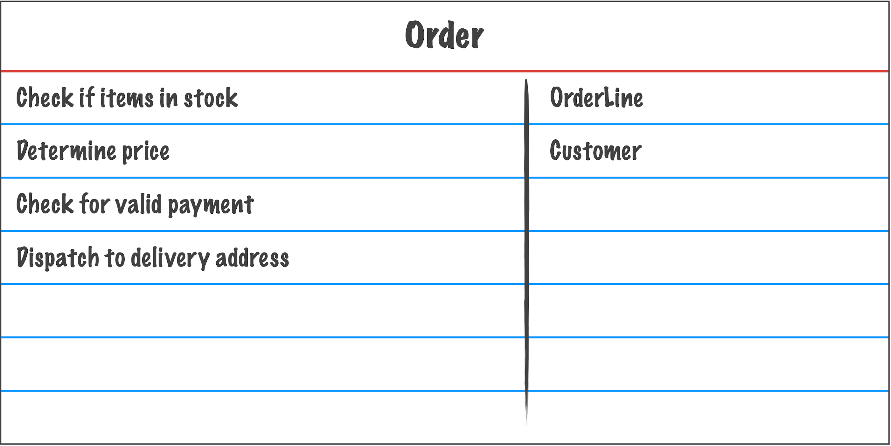
CRC Cards
Class
Responsibilities
Collaborators
Notes:
A CRC card is simply an index card that represents a class in the code. The responsibilities of the class are a high-level abstraction of what the class is supposed to do. Many of these will turn into methods. And the collaborators for each responsibility are the other classes involved in a particular responsibility. In this example, the Order class has the responsibility of checking if a certain number of items is in stock, and it will need help from an OrderLine object to make that determination. Maybe the OrderLine objects hold the name of the item and the number of that item that the customer wants.

Slide 29
XP Design (continued)
Encourages the use of CRC cards: Class, Responsibility, and Collaboration
For difficult design problems, suggests the creation of spike solutions – a design prototype
Encourages refactoring – an iterative refinement of the internal program design
Notes:
Let’s continue with XP Design. In addition to CRC cards, Extreme Programming advocates Spike Solutions. Spike solutions are prototypes that are created help decide which design should be used. The term spike solution sometimes refers to any prototype in XP, not just a design prototype. For example, a prototype to help evaluate requirements might be called a Spike Solution as well.
Finally, XP encourages refactoring, which is a refinement of the program design. Refactoring is an interesting concept that we are going to look at in detail in this course. Based on the definition given here, do you think you can tell me what changes when you refactor, and what stays the same? I know this is a general question, but see if you can take a minute and come up with a reasonable answer, and then I will give you a *clever* answer.

Slide 30
Pause and Think Refactoring
What changes during refactoring?
What remains the same?
Notes:
[pause 5 seconds] Ready? One obvious thing that changes, based on the definition that we mentioned, is the design of the code. But what does that mean “the design of the code”? Does that mean that the code itself changes? [–] The answer is absolutely. Changing the design of the code will cause the code itself to change. So the code will change. Now what are some things that will not change? Well, something that you might think changes but does not, is the performance of the code. Refactoring is *not* optimization. In fact, refactoring may cause the code to have worse performance. The point is that performance is not something you should think about when you are refactoring the code.
The most important thing that does not change is the functionality, or the behavior, of the code. After refactoring, the code should do exactly what it did before refactoring. So refactoring is *not* debugging. You should only be refactoring code that already works.
So what is the clever way to think about this? Well, it’s this: refactoring does not change *what* the does, but it does change *how* the code does it. And it does this in a way that strengthens the design of the code, making it more readable, more understandable, and more maintainable.

Slide 31
XP Coding & Testing
Recommends the construction of unit tests for each story before coding commences
Encourages pair programming
All unit tests are executed daily
Acceptance tests are defined by the customer and executed to assess customer visible functionality
Notes:
Finally, coding and testing in Extreme Programming are very intertwined. XP recommends that unit tests, which are tests for individual components, are written *before* you start coding. This is known as test-driven development, and even folks who are enthusiastic about the benefits of unit testing can find this difficult to do. Unit tests are executed daily. Some of them may be run every few minutes.
Pair programming is also something extreme programming encourages and you might even say that extreme programming made it famous, even though it existed long before extreme programming did. In pair programming, one person programs while the other looks over their shoulder and helps catch mistakes. Every so often they switch places. This is a good way of getting instant feedback on your work.
Acceptance tests are different from unit tests. They are defined by the customer and are meant to test the requirements (or in this case *user stories*) that were created in the planning stage.
All of the phases here are repeated in each iteration again and again until the customer has a product that they feel is ready for release.

Slide 32
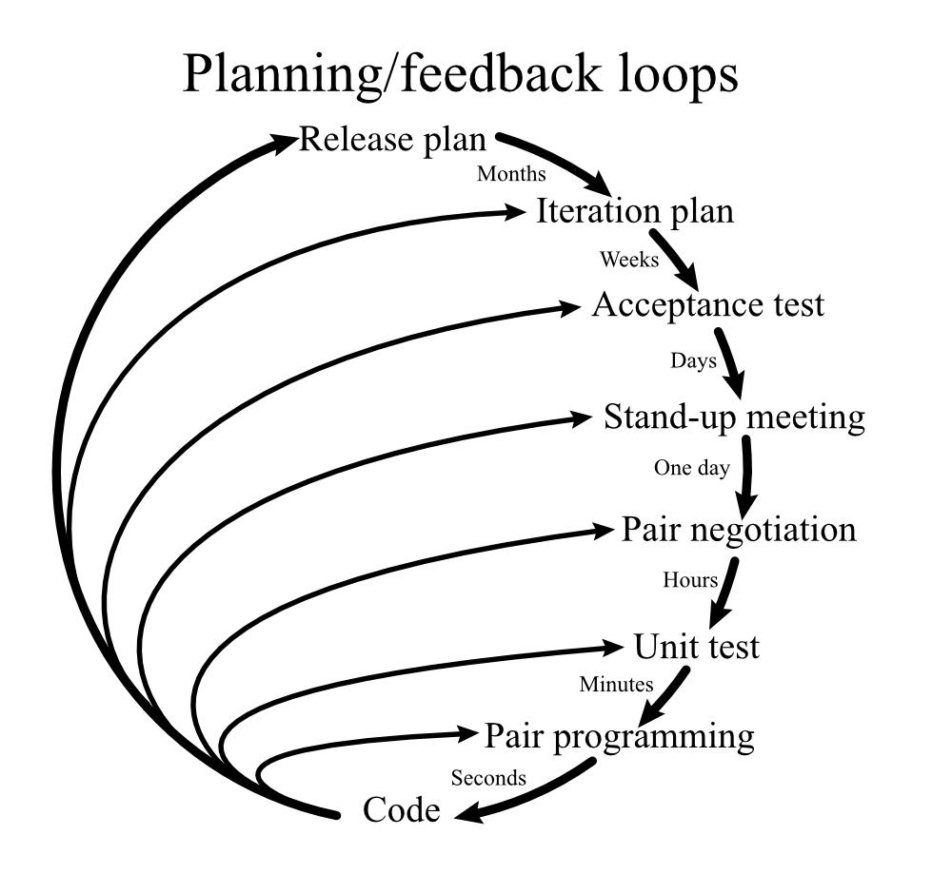
XP Planning & Feedback Loops
— Don Wells, Wikipedia: Extreme Programming
Notes:
I’ll leave you with this image from the Extreme Programming web site. This is a clever depiction of the times that various activities will take in extreme programming.
Pair programming is something that is more or less continuous. Unit testing is conducted every few minutes. Pair negotiation might happen when the two programmers have different ideas on how to proceed with a design issue. Stand up meetings occur every day. Acceptance tests take place every few days. An iteration plan occurs every few weeks. And a release plan might occur every few months.
Okay, the concludes this video on extreme programming. I hope you found it interesting. In the next section, we’ll talk about another agile development methodology that is continuing to gain in popularly, and that is: Scrum.

Slide 33
Scrum
Notes:
In this section, we are going to talk about the agile methodology known as Scrum. At the time of this recording (the Summer of 2020), Scrum seems to be the process model that is getting all the attention. It originated as a *product* development methodology, and was eventually applied to software. The term *Scrum* comes from the game of Rugby and it refers to a formation of players. It was chosen by the people who developed the Scrum technique because it emphasizes teamwork.

Slide 34
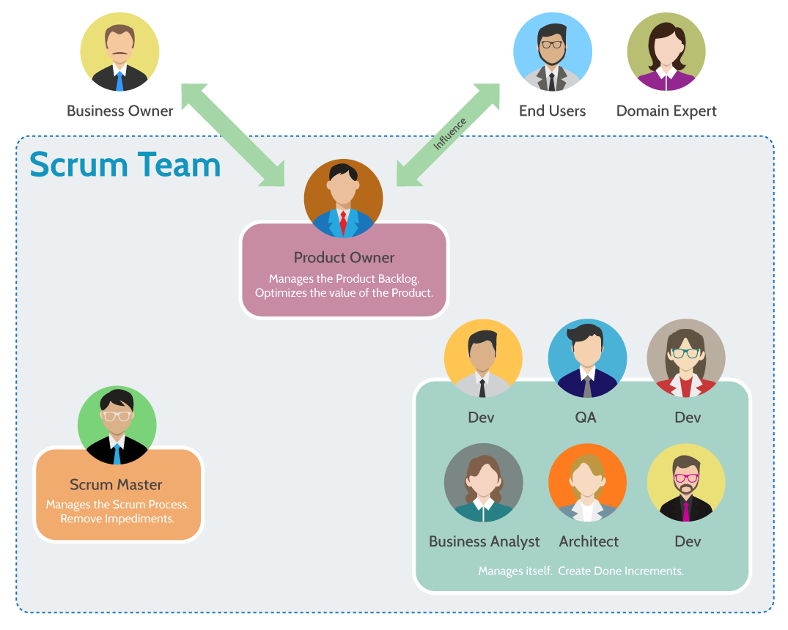
Scrum Team
— Visual-Paradigm.com
What is Scrum Team?
Notes:
The structure of the Scrum team is central to the methodology. The team has three important components: the product owner, the scrum master, and the development team.
The product owner knows what the customer wants, and understands the value the overall product and the features that the product will have. They are in charge of the product backlog, which is a list of features that need to be implemented. The product owner should be able to communicate the importance of the items in the product backlog to the developers.
The scrum master serves as a facilitator to the entire team. She keeps the development team focused on their commitments to the customer and makes sure they are staying productive. She meets with the team on a regular basis to review what they’ve accomplished, and removes any obstacles the members of the team might encounter that would impact their productivity. She also helps the product owner find better ways to manage backlog items and describe the requirements clearly to developers.
The development team typically consists of 3 to 6 people who are responsible for implementing the features in the backlog and making incremental deliveries. Development teams are self-organizing, which means that they get to decide among themselves how best to turn a feature into a deliverable.

Slide 35


Scrum Artifacts
Feature #1
Feature #2
Sprint 1
Sprint 2
Feature #3
Feature #1
Feature #4
Feature #4
Feature #2
Feature #3
Reviewed
Acceptance Tests
QA Tests
Documentation
Feature #5
Feature #6
Product Backlog
Sprint Backlog
Definition of Done
Increment
Notes:
The main artifacts in the Scrum process are the product backlog, the sprint backlog, and the increment, or the delivered software.
Scrum development is based on time-boxed development periods of 2 to 4 weeks called *sprints*. The term *time-boxed* means that the length of the sprint is fixed before it starts, so the development team must deliver whatever they have working in at the end of the sprint. I’ve been assured by several students who have worked with scrum development that, in practice, teams deliver everything they originally promised, mainly because the increments are short, so estimation is easier, especially for experienced teams.
The product backlog is a prioritized list of requirements that have to be implemented. Most of the requirements are features, but they can also be enhancements or fixes that need to be made to the product for future releases. The product owner determines what goes into the product backlog and in what order.
The sprint backlog is a set of product backlog items (sometimes called PBIs) and a plan for delivering the increment. The development team will decide how many PBIs to implement in the upcoming sprint, how long the sprint will last, and what will constitute a completed increment, which is also referred to in scrum-speak as the “definition of done”. Once the sprint starts, no new features can be added to the sprint backlog unless the sprint is cancelled and restarted.
Finally, the increment is the code delivered at the end of a sprint.

Slide 36
Sprint Meetings
Sprint planning meeting
Daily Scrum meeting
What have you done?
What are your obstacles?
What will you do?
Sprint review meeting
Sprint retrospective
What went well?
What could be improved?
What will be improved?
Notes:
A sprint planning meeting is conducted prior to the sprint. The product owner states their goal for the coming sprint, then the development team – with the help of the scrum master – decides what they can reasonably accomplish in the constrained time frame.
In a daily scrum meeting, the development team and scrum master meet. Each team member answers three questions: (1) what did you do since the last meeting, (2) what obstacles are you encountering, and (3) what do you plan to accomplish before the next meeting. The scrum master is responsible for clearing away the obstacles.
A sprint review meeting is attended by all team members, including the product owner. It occurs at the end of a sprint and typically involves a demo of the software increment to be delivered, and whether it meets the definition of done. An code increment that is done should be potentially *shippable*, regardless of whether the customer will release the new code or not.
During a sprint retrospective, the scrum master and the development team meet and assess how they did during the sprint. The try to determine what went well, what could be improved, and decide what – if anything – they will commit to improving in the next sprint.
There are a lot of meetings defined by the Scrum methodology (and there are still more than we’ve talked about here). One reason is to keep the team focused and on-track. All of the meetings are relatively short. For example, the daily scrum meetings are “stand-up” meetings. They should only be about 15 minutes long, so that people do not even need to sit down. The sprint review is an hour for each week of the sprint. So a 3 week sprint will have a 3 hour review.

Slide 37
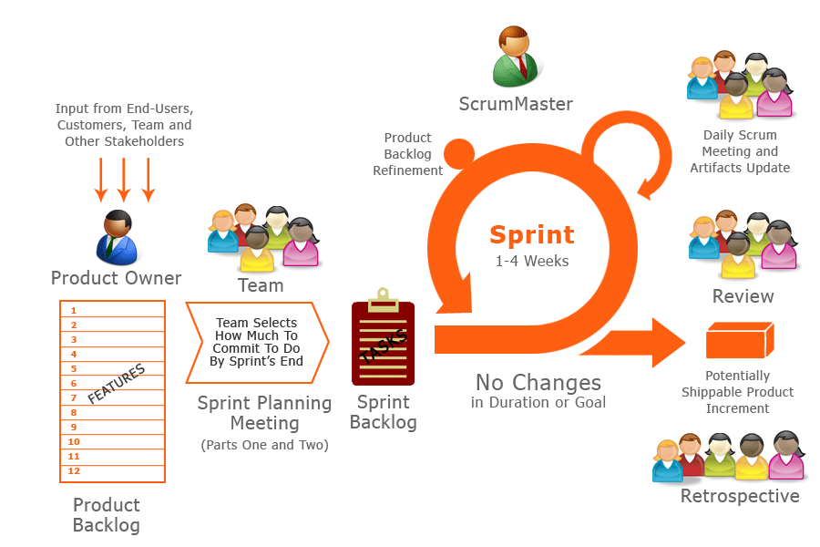
Scrum Methodology
— found on agilelucero.com: Scrum Plus
Notes:
Here is a graphical depiction of the entire scrum methodology. The product owner manages requirements. He or she should have the best overall vision of what the product will do. The product owner is continually gathering and prioritizing requirements from various stakeholders in the form of user stories. As in any agile method, these features may change as the project progresses.
At sprint planning meeting, features are analyzed, acceptance tests are developed, and a quick design is created for each requirement. All this helps the team decide what should actually go into the next sprint. Once this is done, the goals and the delivery time for the sprint or fixed and cannot change. This gives the team some stability even though they are working in an agile environment.
The scrum master is in charge of the sprint. Everyday there is a scrum meeting – usually about 15 minutes – where each team member is asked the three questions we talked about previously: What have you done, what obstacles do you face, and what will you do. At the end of the sprint the deliverable is reviewed and if all goes well you have a potentially shippable product increment.

Slide 38
Kanban
Notes:
Kanban is a methodology that can help improve any process or workflow. It is focused on change management and service delivery. It started at Toyota as an industrial engineering practice, and was adapted to software development.

Slide 39
Kanban Practices
Visualize your workflow
Limit work-in-progress
Make policies explicit
Manage workflow
Implement feedback loops
Improve collaboratively, evolve experimentally
Notes:
There are two primary practices in Kanban: visualizing your workflow, and limiting your work-in-progress. The other four practices listed here – making policies explicit, managing workflow, implementing feedback loops, and making changes collaboratively – are secondary practices.

Slide 40
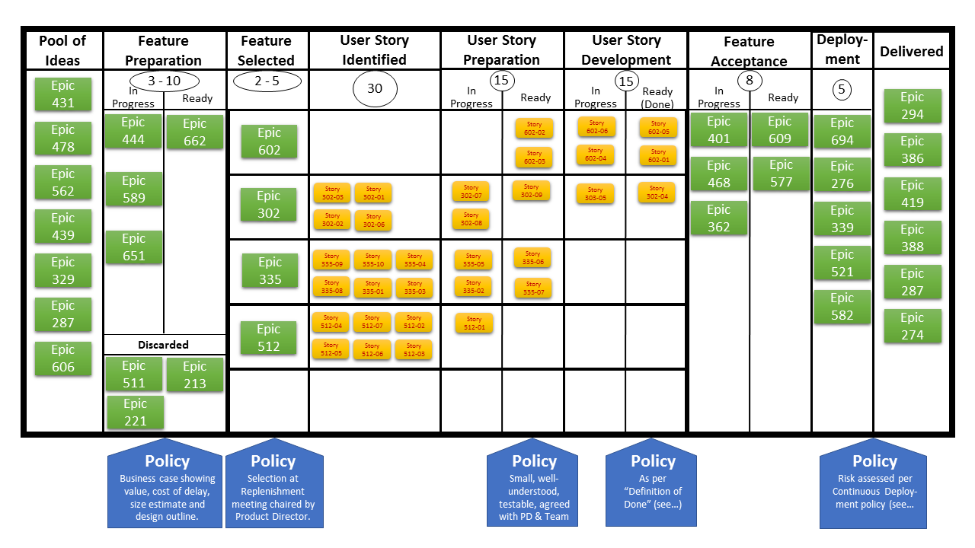
Kanban Board
— Andy Carmichael Wikipedia: Kanban
Notes:
The primary instrument used in the Kanban methodology is the Kanban board. Kanban boards vary widely in their design.
This image of a Kanban board is from the Wikipedia article on Kanban. It supports the first primary practice of allowing the development team to visualize their work in the form of features (also called epics) and user stories. It supports the other primary practice by giving explicit limits to work-in-progress items. The circled values below the column headings give the allowable number of work items for that step.
The board also makes policies explicit using the blue callouts under some of the development steps. These policies are also known as done rules. It incorporates workflow management for some of the steps by having “in-progress” and “ready” columns. The circled work-in-progress limit applies to both columns, so that work items don’t overwhelm the flow in or out of those steps.

Slide 41
DevOps
Notes:
Like Kanban, DevOps is not so much a process model as it is a set of practices. It was created to combine software development (which is the *dev* part) with IT operations (which is the *ops* part). We already know that when developers deliver software, their job is far from done. If they delivered an increment, they have to start the next increment. If they delivered a finished product that the customer is going to release, there will have to beta-testing, where real users use the software with the understanding that it may not be completely stable yet. Even with stable releases, we know that there will be maintenance. On average, 60% of software costs go to maintenance, and 60% of maintenance costs go to enhancing the software with new features. Given all of this, it seems reasonable to include the users of the software in our process, particularly for software that will be used in the context of a complete system, with IT professionals operating and monitoring the product.

Slide 42
DevOps Stages
Continuous development
Continuous testing
Continuous integration
Continuous deployment
Continuous monitoring
Notes:
The DevOps approach consist of multiple continuous stages including continuous development, testing, integration, deployment, and monitoring. The monitoring is done by operations staff who are on the development team. They monitor the software for performance and functionality in a production environment, looking for problems before *actual* users find them.

Slide 43
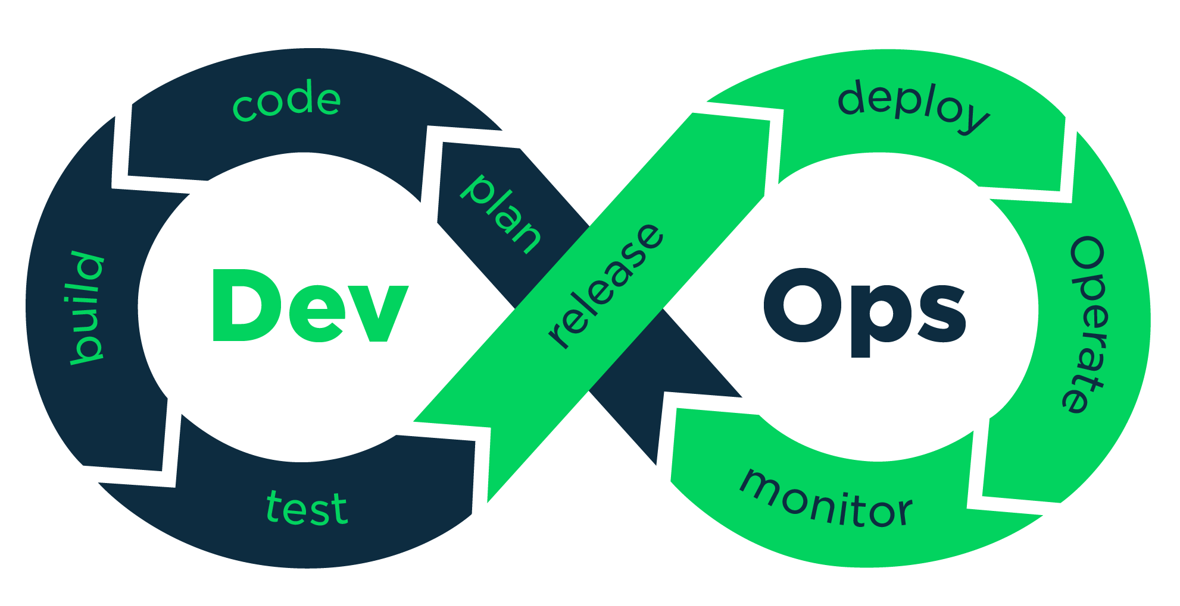
DevOps Workflow
— Pease, 2017 devopedia.org/devops
Notes:
The is a nice diagram of the DevOps workflow from devopedia.org. The development activities – plan, code, build, and test – are on the left, and the the operations activities – release, deploy, operate, and monitor – on the right. The idea is that fixes and improvements from the operations side are continuously being integrated into the plans of the development side.

Slide 44
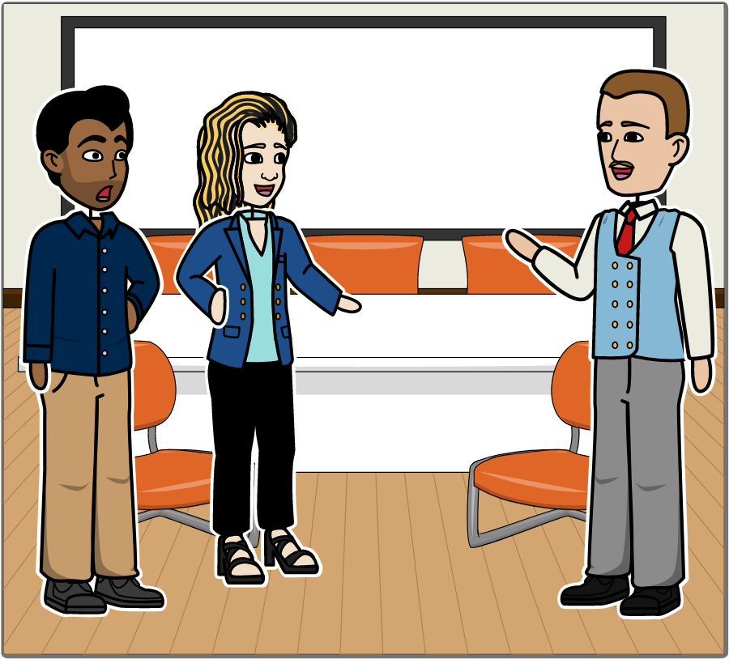
SafeHome: Considering Agile [1]
I like the sprint concept and the emphasis on early test creation.
I was talking to a friend about Scrum and it sounds pretty good!
You can develop fast.
You use sprints to deliver increments when the team decides the product is done.
And I like the idea that the product owner is part of the team.
Notes:
Okay, let’s get back to our SafeHome script. In this series, the development team is considering agile development. In particular, they are talking about Scrum. In this frame, Jamie and Vinod have recently been discussion Scrum with a friend, and they are trying to convince Doug that agile is the way to go. Doug is of two minds on Scrum. One thing he likes about it, is that the product owner is part of the team.

Slide 45
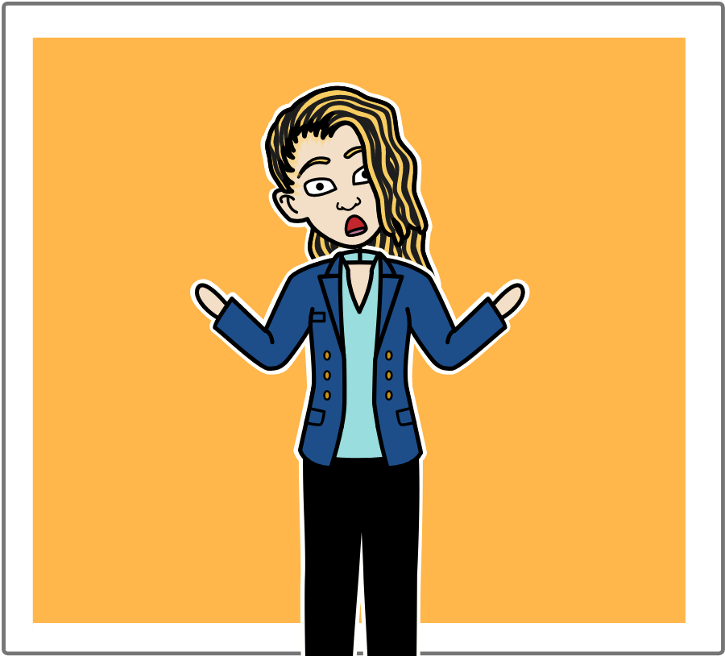
SafeHome: Considering Agile [2]
Huh? You mean that marketing will work on the project team with us?
They’ll be wanting changes every five minutes!
Notes:
When Jamie hears this it makes her nervous. She’s afraid that the customers – which in this case probably means the people from marketing – are going to be making changes to their requirements every five minutes. She’s not entirely wrong, sometimes the product owner is someone from marketing.

Slide 46

SafeHome: Considering Agile [3]
The marketing team are stakeholders, but only one person can be the product owner.
For us, it would probably be Marg, from product management.
Notes:
Doug assures her that even though the marketing team are stakeholder, there can only be one product owner. In this case, it will probably be someone from product management. Regardless of who the product owner is, keep in mind that the Scrum methodology has strict rules about how and when you can introduce requirements. For example, you cannot change the requirements of a sprint that has already started.

Slide 47
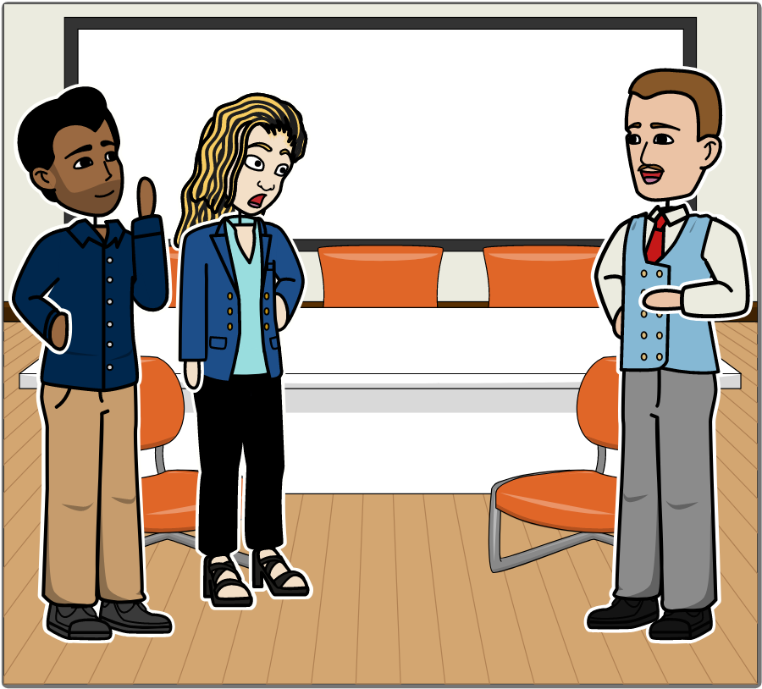
SafeHome: Considering Agile [4]
The only thing I don't like is the way that Scrum downplays analysis and design...
I just hope she can filter the changes that marketing will want.
It sort of says that writing code is where the action is.
Be agile. Embrace change!
Notes:
Jamie seems a bit more calm about having Marg as the product owner, while Vinod is whispering to her that she should embrace change. [–] Doug tells Jamie and Vinod what he doesn’t like about Scrum (and probably agile in general). Namely, that it downplays analysis and design, and it focuses a little too much on coding.

Slide 48
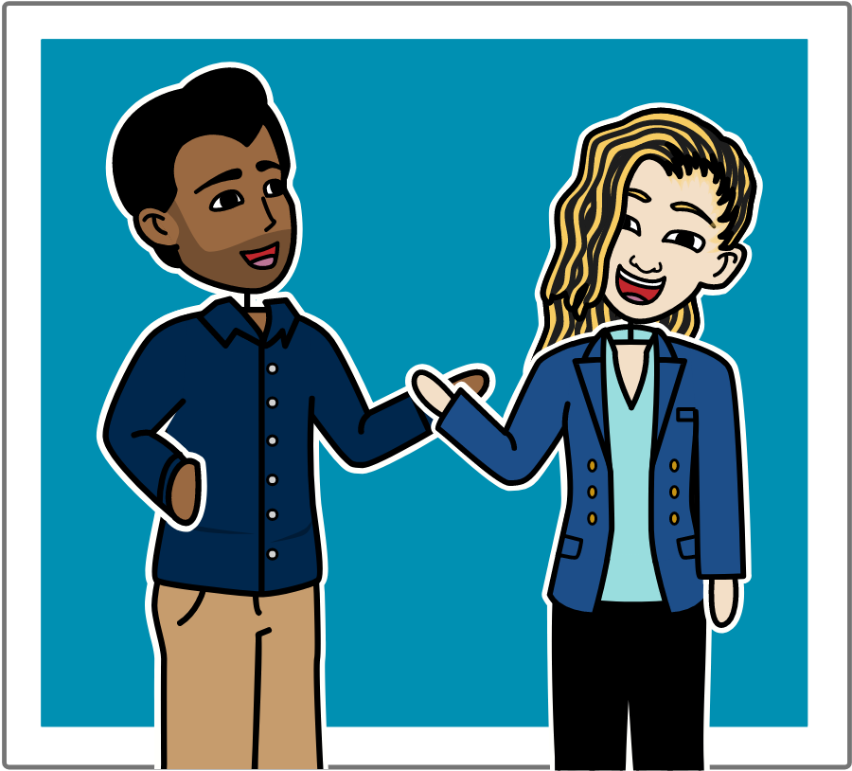
SafeHome: Considering Agile [5]
Writing code is what we do, Boss!
Notes:
Of course, Jamie and Vinod are happy to focus on coding, because that’s what they do.

Slide 49
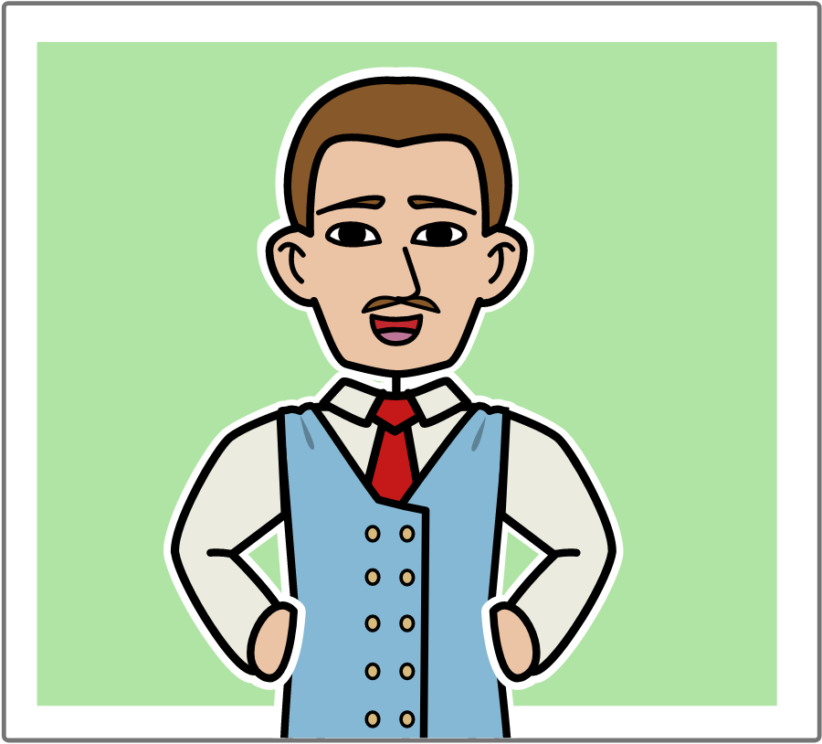
SafeHome: Considering Agile [6]
That’s true!
and designing a solution that works!
but I'd still like you to spend a little more time analyzing the problem...
Notes:
But Doug is still insistent that analysis and design should be an important part of the process, even if agile development is used.

Slide 50
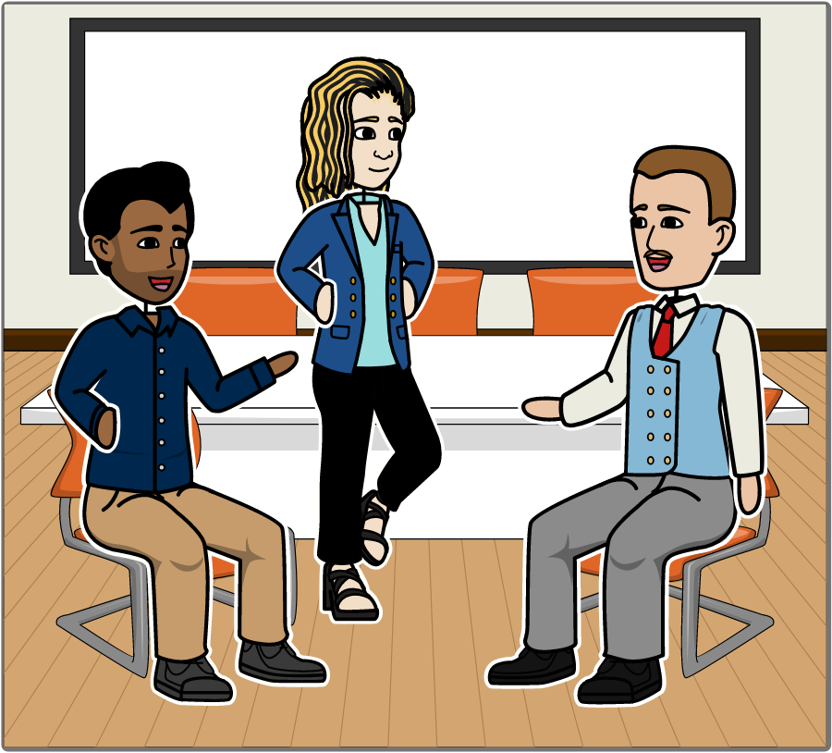
SafeHome: Considering Agile [7]
Maybe we can have it both ways: agility with a little bit of discipline!
I think we can, Vinod. In fact, I’m sure of it!
Notes:
Finally, Vinod suggests that they might be able to have both agility and discipline, and Doug wholeheartedly agrees. This is not very surprising, since we mentioned back in Module 1 that one of the themes in Pressman is that of balancing agility with discipline, and another is being able to adapt a software process to fit your needs.
And that’s it for Module 3. I’ll see you again in Module 4.

Slide 51
Extra Slides
Notes:
…

Slide 52



Scrum Teams
Project Owner
Scrum Master
Development Team
Notes:
A Scrum team is made up of a Project Owner, a Scrum Master, and a Development Team.

